Slide 1
Putting the R in Bain
AC Innovation Next-Gen Toolkit, Oct 2015

Slide 2
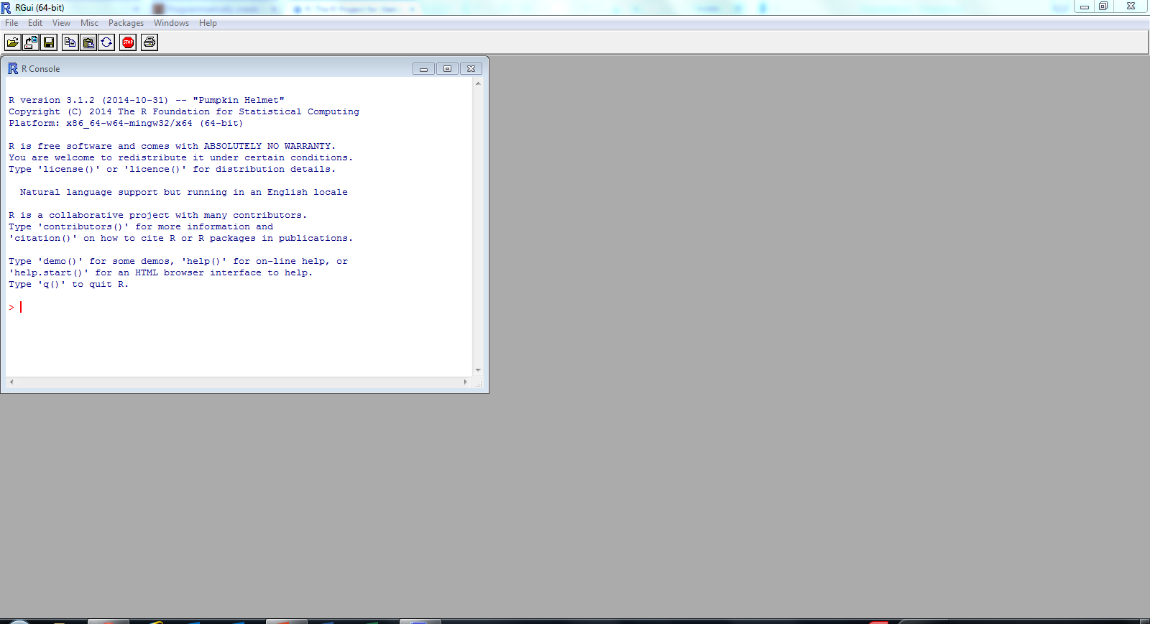
Go ahead and download and install R
3_85
One of the great things about R… it’s entirely free! No license required
That means you can use this beyond your time at Bain, unlike Altyerx or Tableau
Visit r-project.org to get started, and follow the instructions there

Slide 3
Why you should learn R
6_89 7_84
R is the “lingua franca” of statistical analysis
In the top 20 of all programming languages by usage
Lots of companies, especially forward-thinking ones, use R
Facebook, Google, Uber, Bank of America, etc.
R is actually pretty easy to use
You’ve already seen a lot of the basics… now just play around with it!
R is free and open-source, so you’ll always have access to it
It’ll also continue to be improved by the community
R has an insanely great, helpful community around it
You can essentially always Google the answer to any question you have
R skills will make you better at your job at Bain and a more competitive applicant for your next job

Slide 4
What can R be used for?*
3_85
Simple data analysis
Not-so-simple data analysis
Repeating analyses on updated data with the same format
Exploring new data sets
Visualization
Manipulating large data sets
Regression analysis
Cluster analysis
Simulation & Monte Carlo
Mapping and spatial analysis
Times series analysis
Statistical testing
Data mining
Machine learning
Financial analyses
Interactive dashboards
Distributed computing
Signal processing
Natural language processing
*Statisticians will tell you “it’s mostly used for pirate jokes.”
Note: Bold means likely most relevant for your work at Bain

Slide 5
The ceiling of what you can do is sky-high
6_89 7_84
Display animated maps based on data
Create interactive charts
Control PowerPoint from R via the API to auto-populate slides
Send batches of emails
Implement a cryptosystem (with horrendously slow code)
R is really a programming language, so you can do just about anything you might ask of a computer!

